Slide 1

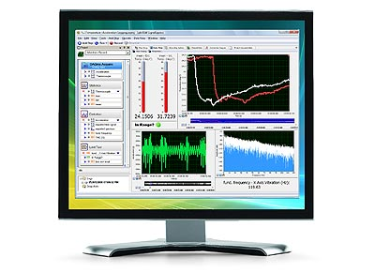

INFORMATION TECHNOLOGY INSTITUTE
MECHATRONICS 9 MONTHS PROGRAM
LabVIEW Fundamentals Course
SESSION 3
Waleed A. El-Badry
wbadry@must.edu.eg

Slide 2

Data transportation
Shift register

Slide 3
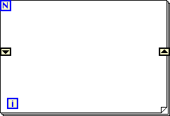
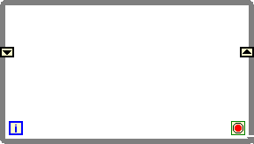
WHAT IS SHIFT REGISTER ?
It is a technique used to transfer data from previous iteration to current iteration i.e. (t-1) → t
Mainly used in data collection ( with arrays).
Can be created in loops (WHILE and FOR structures)
Data transferred are of same data type
X₀
X_{t-1}
X_{t}

Slide 4
Exercise 1
Calculating sum of n numbers

Slide 5
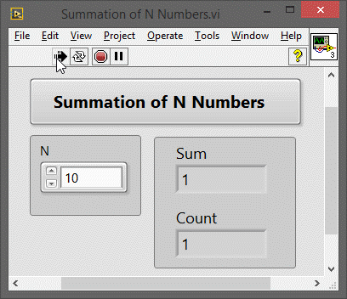
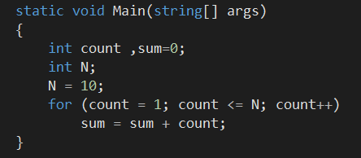
SUM OF N NUMBERS

Slide 6
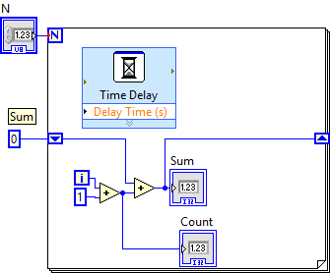
SUM OF N NUMBERS

Slide 7
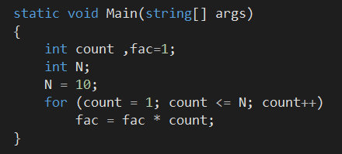
ASSIGNMENT (Factorial N!)

Slide 8
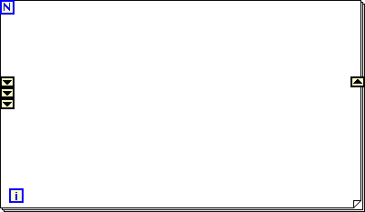
STACKED SHIFT REGISTER
X_{t-3}
X_{t}
X_{t-2}
X_{t-1}

Slide 9
Data Collection
Arrays

Slide 10
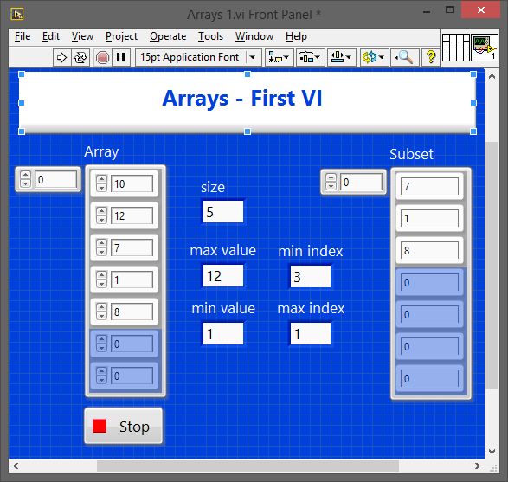
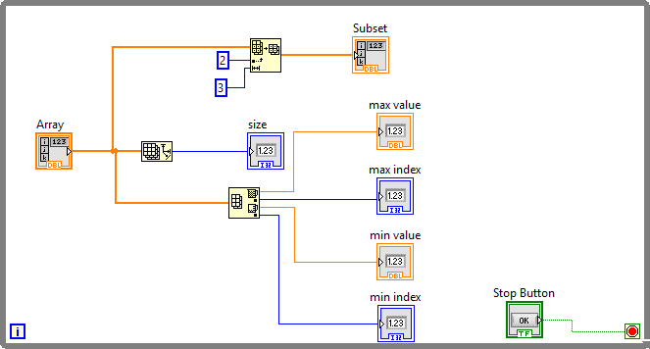
ARRAY OPERATIONS

Slide 11
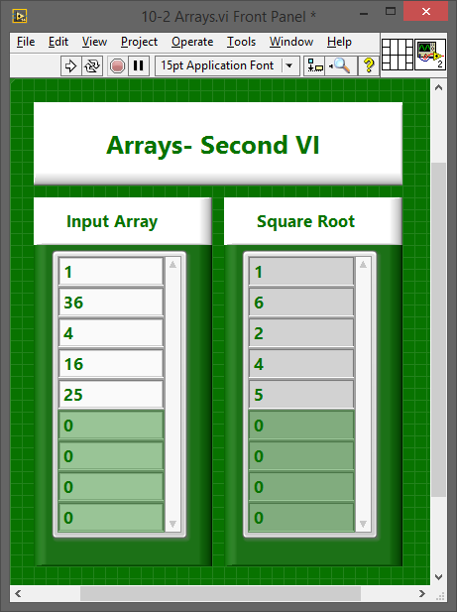

ARRAY OPERATIONS
Auto indexed tunnel

Slide 12
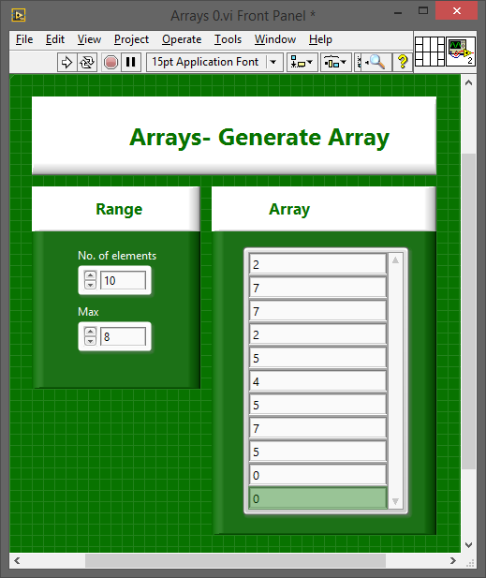
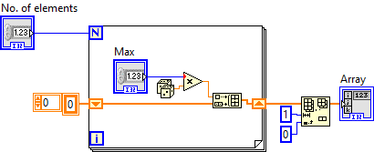
ASSIGNMENT

Slide 13
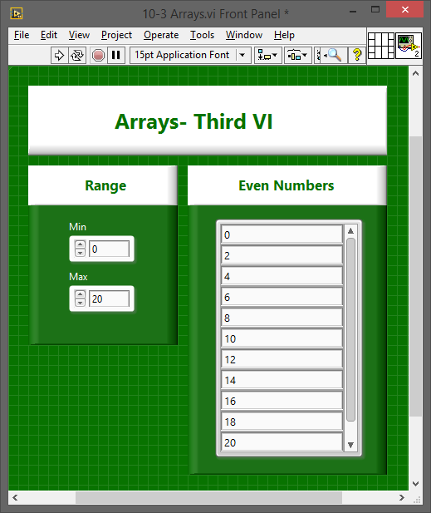
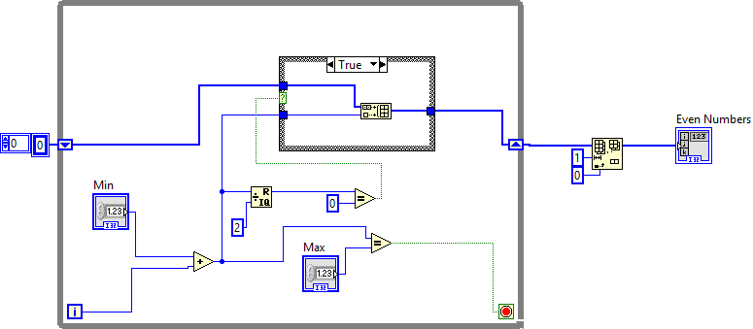
ARRAY OPERATIONS

Slide 14
END OF SESSION 3

